Slide 1

What Every UGA County Agent Should Know About Weed Science
Eric P. Prostko
Extension Weed Specialist
Dept. of Crop & Soil Sciences

Slide 2
General Thoughts
Herbicides are unpredictable
  influenced by everything: sprayer, soil type, temperature, moisture, humidity, weed species, stage of growth, etc. etc.
  when things go bad, they can go really bad!
    fungicides/insecticides rarely (never?) kill crops
Herbicides
    do not guess
    do not assume
    share only results based on repeatable sound science

Slide 3
Herbicide Application Methods
Preplant Incorporated (PPI)
Preemergence (PRE)
Postemergence (POST)
  Cracking
  Early-Post (EPOST)
  Late-Post (LPOST)
Lay-By or Post-Directed

Slide 4
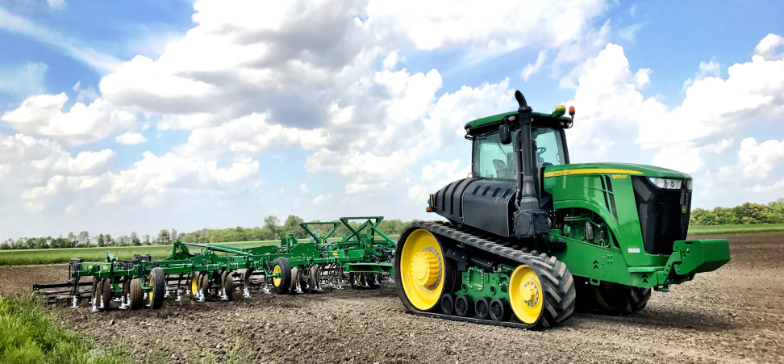
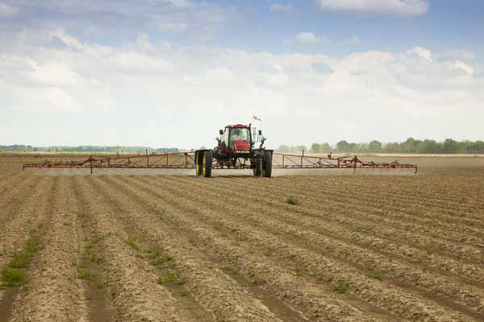
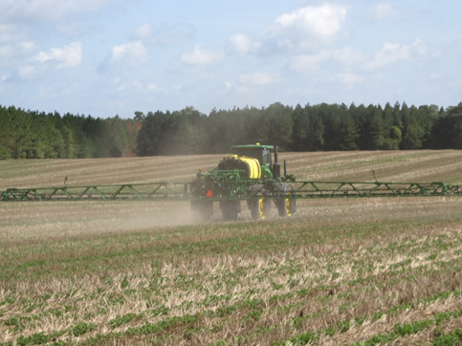
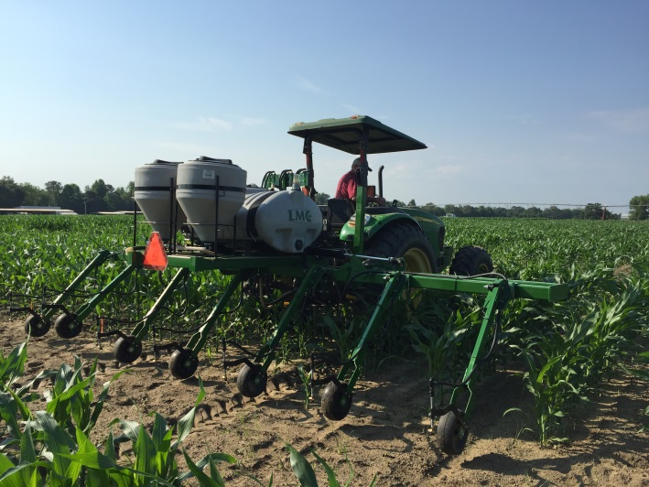
Herbicide Application Methods

Slide 5
What Every UGA County Agent Should Know - I
Water pH and hardness are not the same thing
atrazine is awesome
ALS Herbicides
OP/ALS/HPPD/Hybrid Interactions
Know your grasses
metribuzin is awesome
glyphosate does not cause nutrient deficiencies

Slide 6
What Every UGA County Agent Should Know - II
Valor will cause peanut injury but so what!
No way to predict Cadre carryover to cotton!
  Lime/pH
  other ALS herbicides (Staple, etc.)
Use Concep treated seed with Dual or Warrant on grain sorghum
Nematodes and soil fertility problems cause more issues than herbicide carryover.
Glyphosate/picloram/peanuts

Slide 8
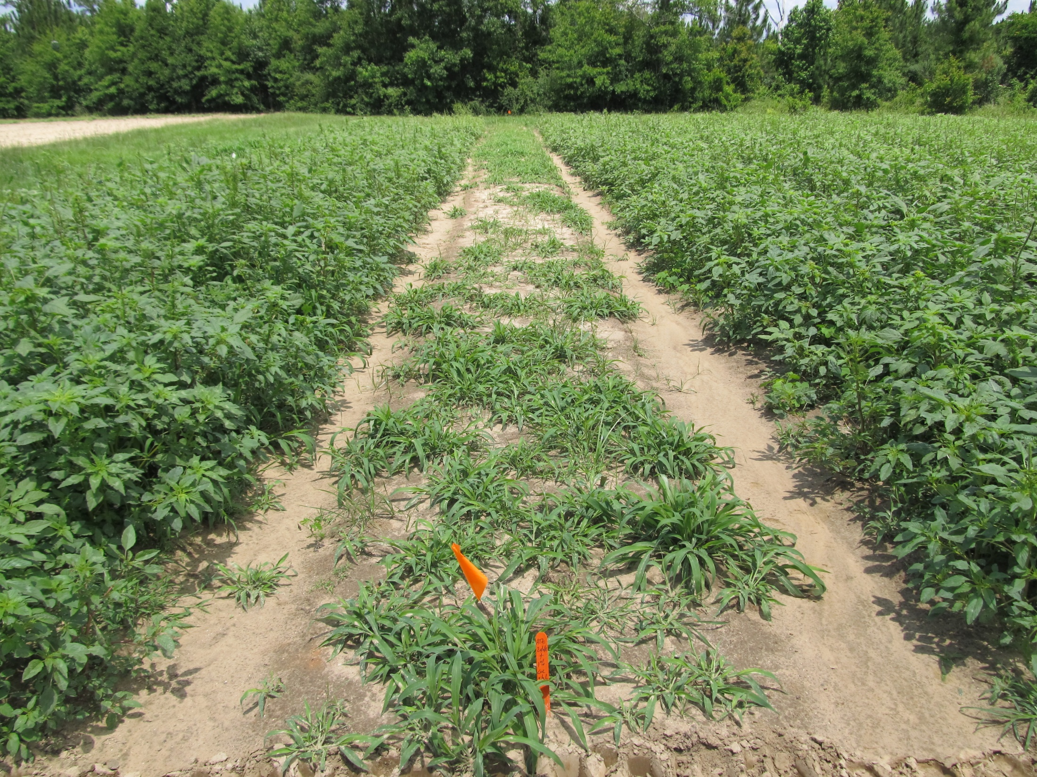
Atrazine 4L @ 2 qts/A + COC @ 1% v/v
Applied to 4”-9” Palmer Amaranth (6” average)
Photo 13 DAT

Slide 9
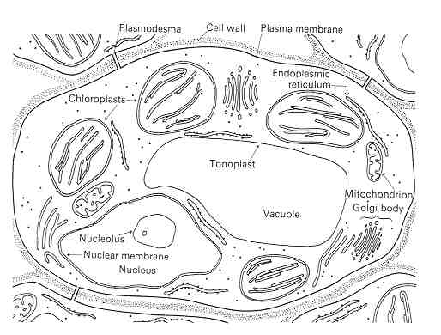
What does ALS mean?
Acetolactate synthase (ALS)
Acetohydroxyacid synthase (AHAS)
chloroplast enzyme needed to form certain amino acids
  Valine, leucine, isoleucine
Herbicide families
  Imidazolinone, sulfonanalide, benzoates, sulfonylurea

Slide 10
Commonly Used ALS Herbicides
Accent
Ally/Cimarron
Beyond
Cadre
Classic
Envoke
Express
Finesse
FirstRate
Harmony Extra
Maverick Pro
Osprey
Permit/Sandea
Powerflex
Pursuit
Python
Staple
Steadfast Q
Strongarm

Slide 11
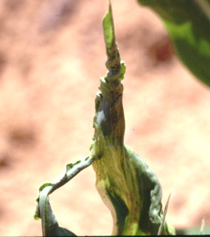
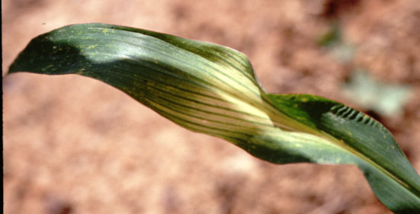
Insecticide/Herbicide Interactions
Insecticides
  Organophosphates (OP’S)
  Counter, Lorsban, Thimet
Herbicides
  Steadfast Q
  Capreno
  Halex GT
  Sandea
Why?
  overload the plant’s ability to metabolize chemicals

Slide 12
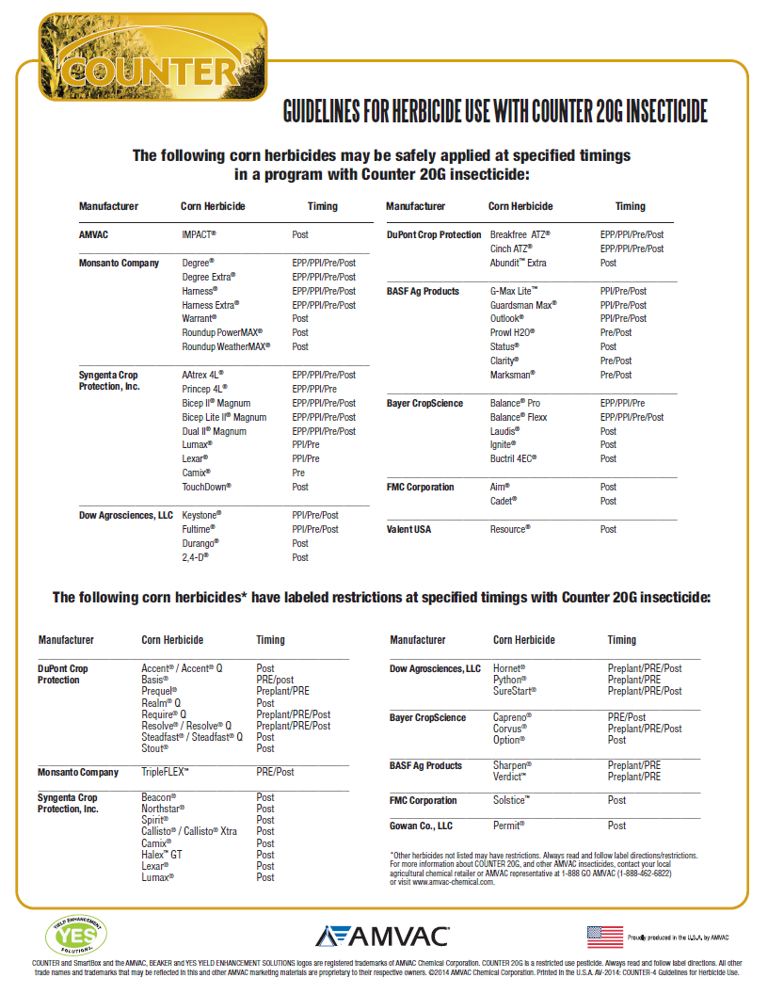

Slide 13
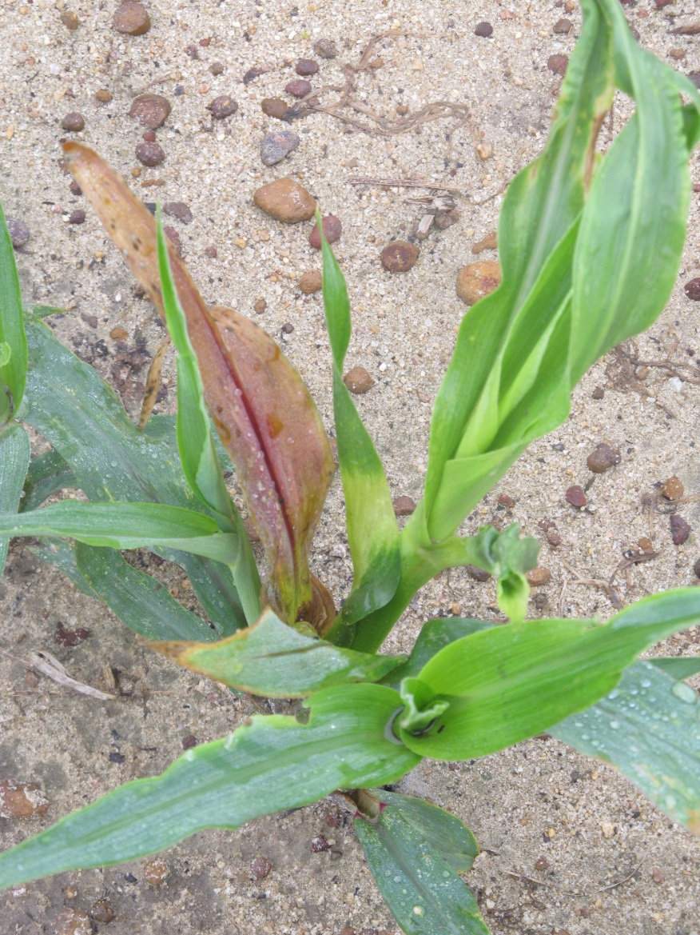
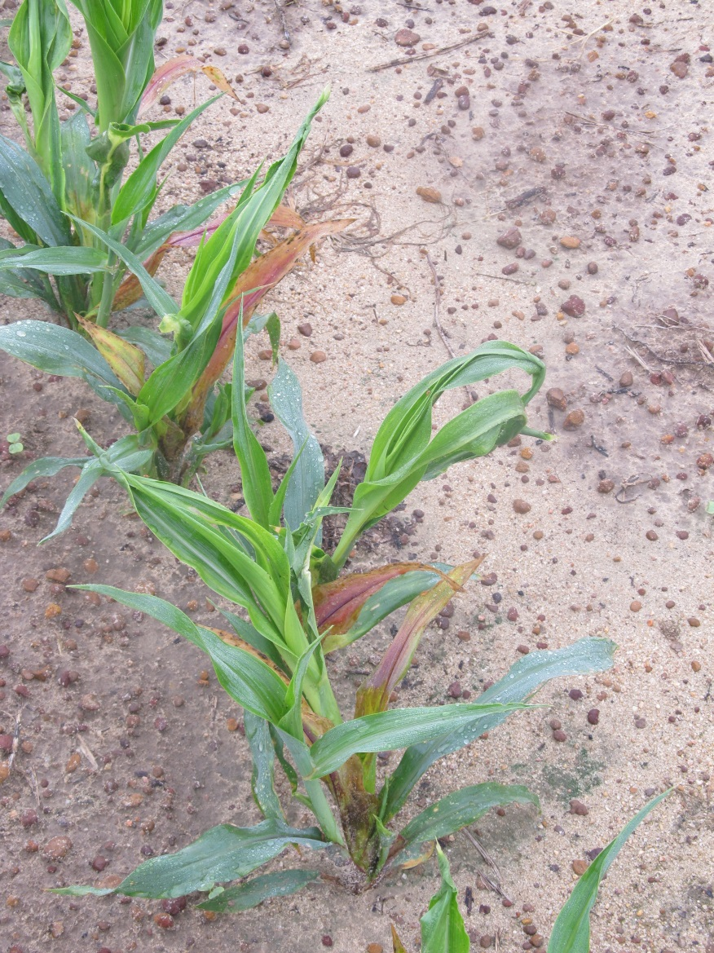
Counter 20CR @ 6 oz/A (INFR) FB Steadfast 75WG @ 0.75 oz/A + NIS @ 0.25% (V3-V4)
CN-06-12
DKC 66-97
15 DAT

Slide 14
Field Corn (DKC 66-97) Yield Response to Counter fb Steadfast - 2012
LSD 0.10 = 26
CV = 12.82
-43.5%
Bu/A
Treatment
CN-06-12

Slide 15
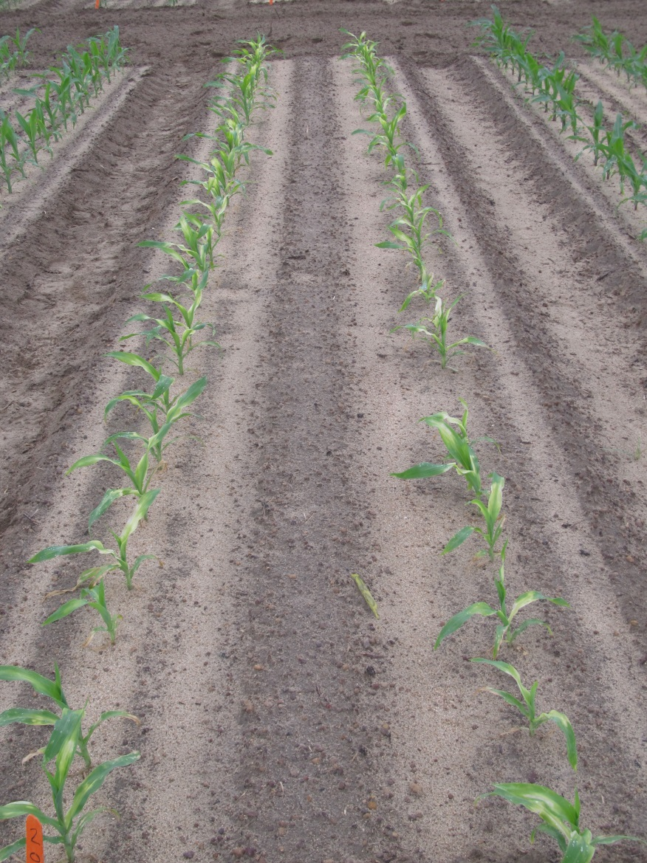
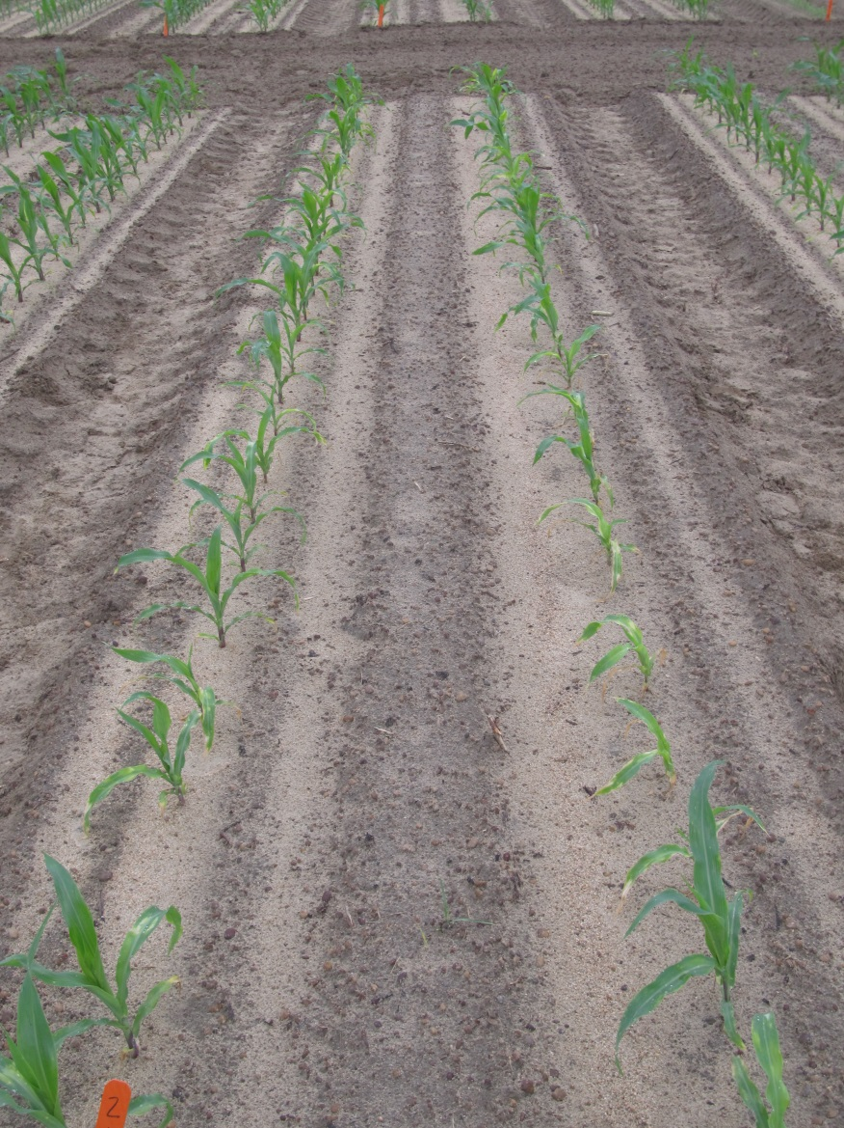
Counter 15G (INFR) fb Halex GT + Atrazine + AMS + NIS (V4)
DKC 62-08
P1794VYHR
CN-07-17
April 24
6 DAT

Slide 16
Field Corn Hybrid Yield Response to POST Applied Acuron or Halex GT with/without Counter INFR - 2017
LSD 0.10 = 5
CV = 2.4
CN-07-17
*21,606 plant population

Slide 17
ALS-Sensitive Field Corn Hybrids
Dekalb
  WARNINGS
    DKC 62-05
    DKC 62-06
    DKC 62-08
    DKC 63-44
    DKC 63-47
    DKC 63-55
    DKC 64-69
  CAUTIONS
    65-17, 65-18, 65-20
    70-01, 70-03
    RX940, RX940RR2
Pioneer
  WARNINGS
    P1324HR
    P1360
    P1360AM
    P1360CHR
    P1360HR
    P1739R
    P1739YR
  CAUTIONS
    P1637R, P1637VYHR, P1637YHR
    P1690,P1690HR, P1690R
    P2088R, P2089YHR

Slide 18
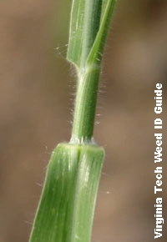
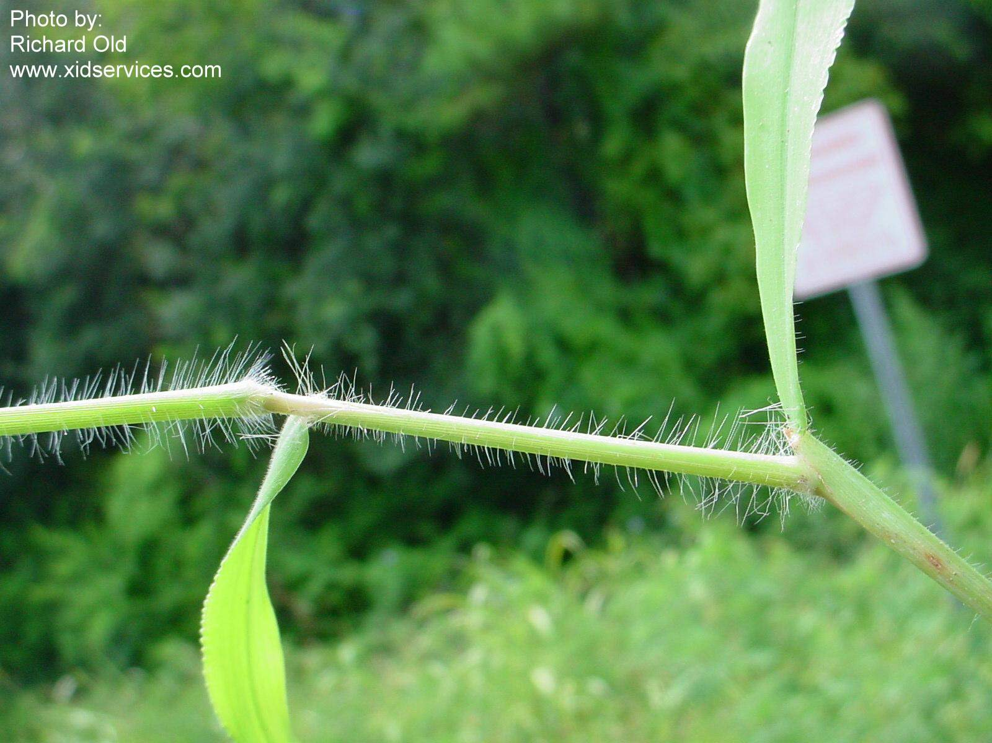
Texas Panicum vs. Crabgrass
Fringe of
hairs
membranous
WSSA
Southern crabgrass
Texas panicum

Slide 19
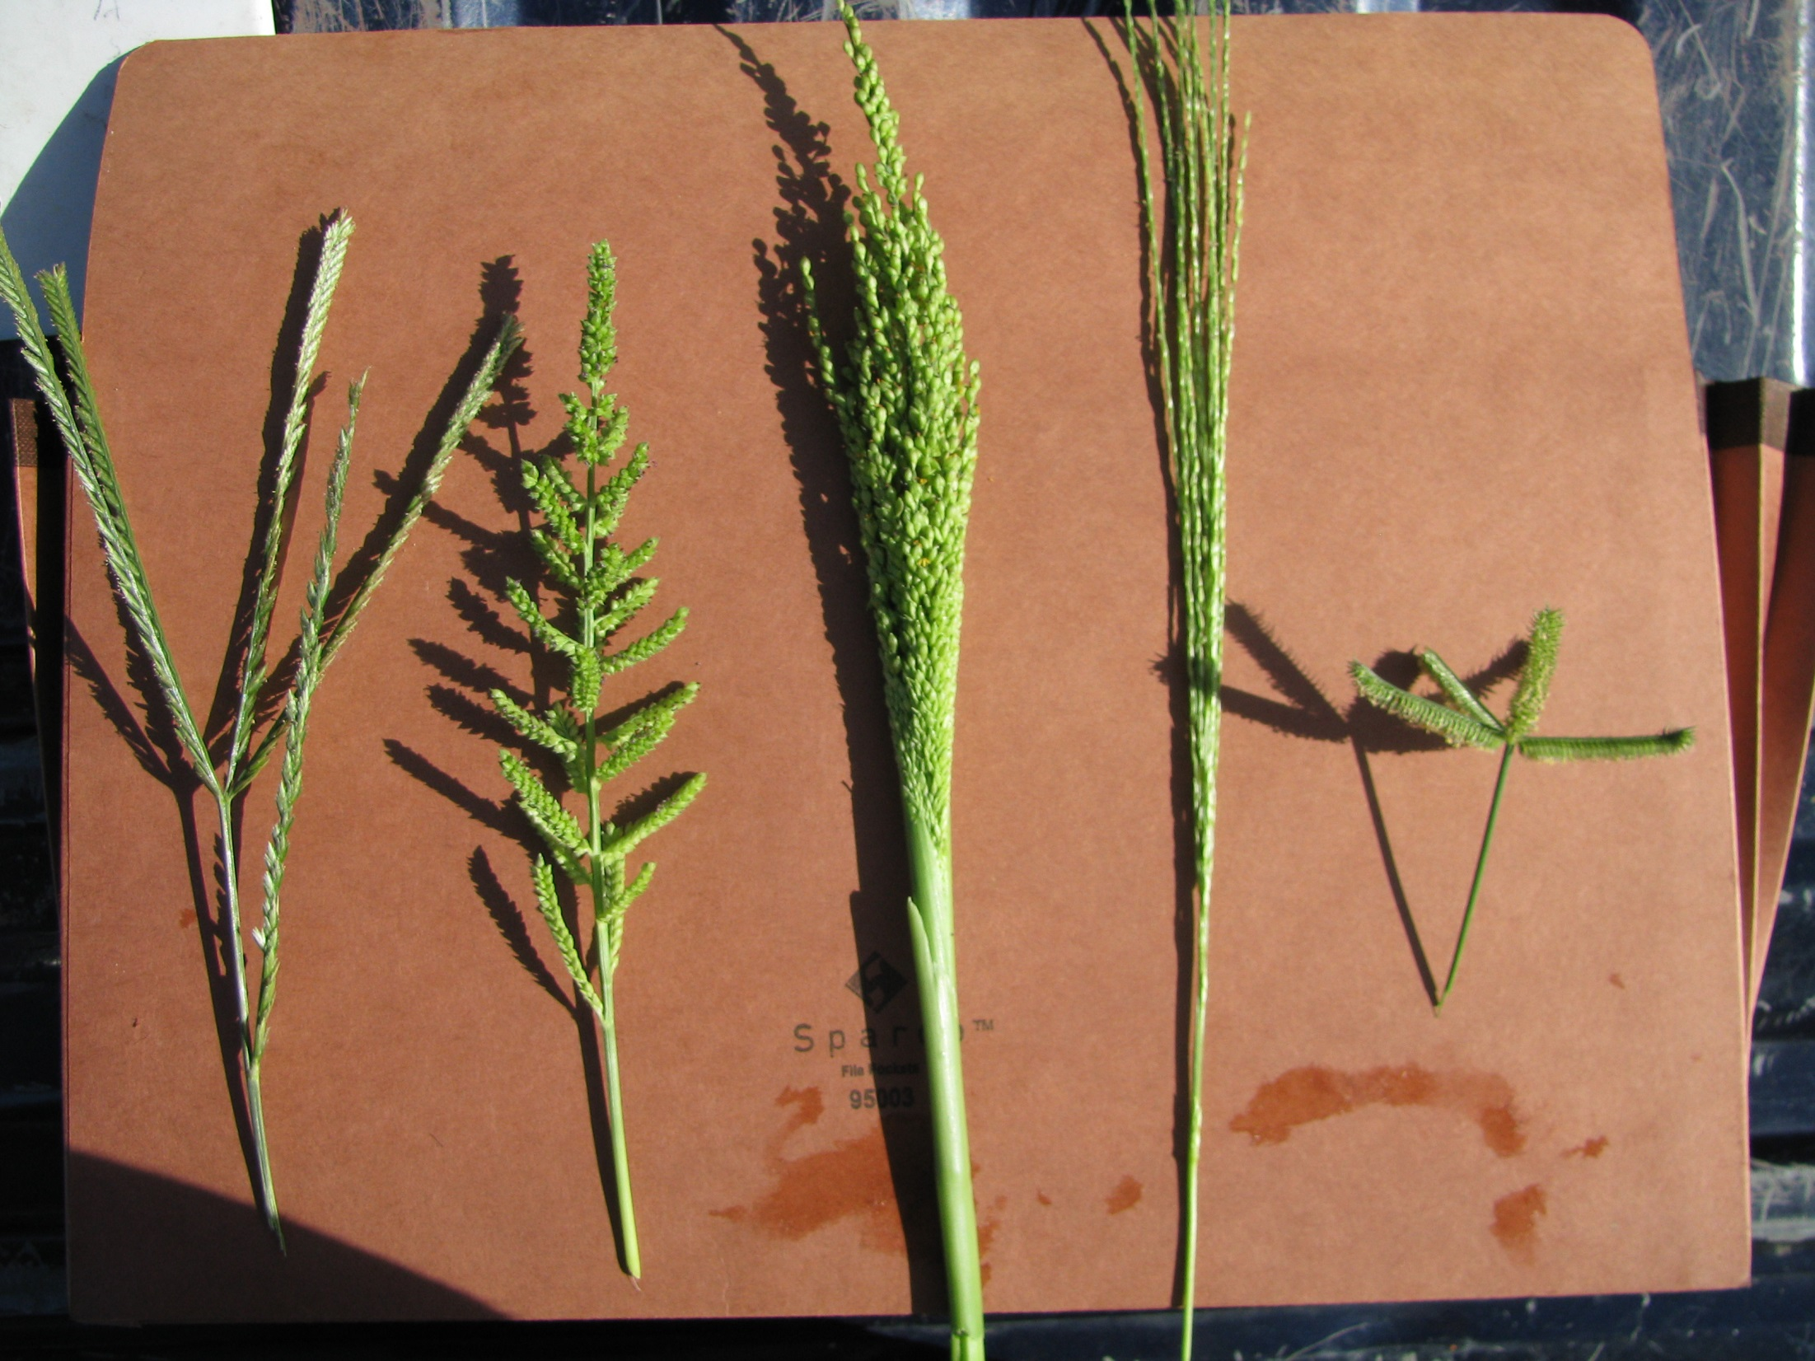

Slide 20




Metribuzin on soybean
Sencor/Lexone
Not a PPO (Valor or Reflex)
triazine
Good on pigweed and sicklepod
Can be applied PPI
  Dryland fields?
Issues
  soil texture, OM, pH
  Varieties
  Rotations
  Company support
  Lack of incentive at dealer level
TriCor 75DF
Metribuzin 75DF

Slide 21
Metribuzin Use (%) – US Soybeans (NASS)
Commercial Sale of Sencor began in 1973
RR
Command – 1985, Scepter - 1986, Pursuit - 1989

Slide 22
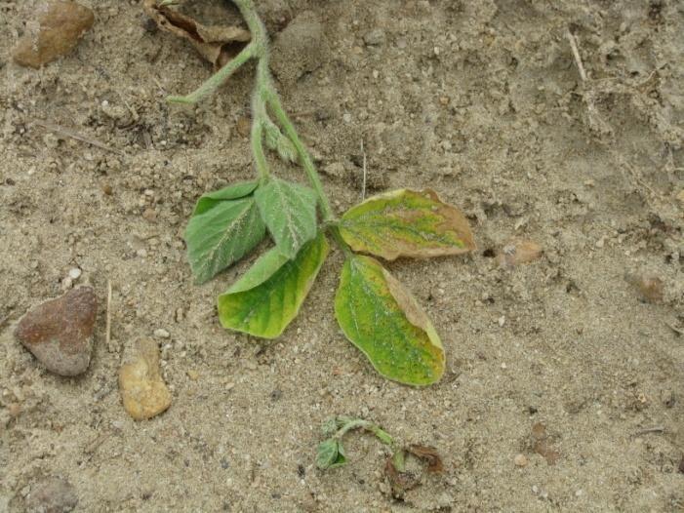
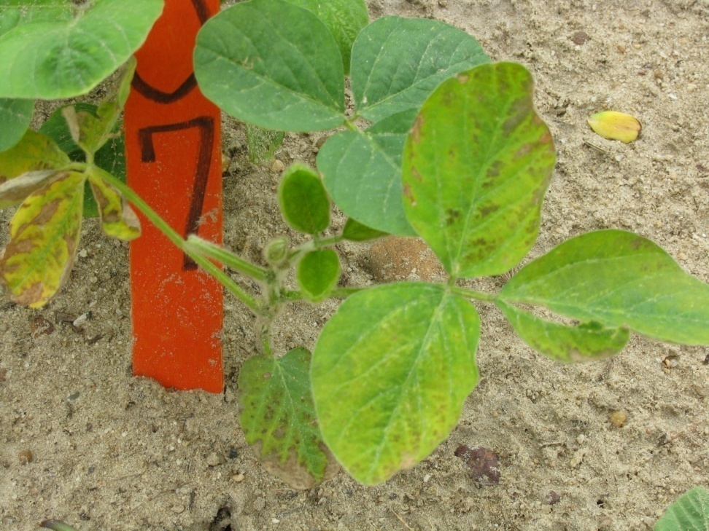
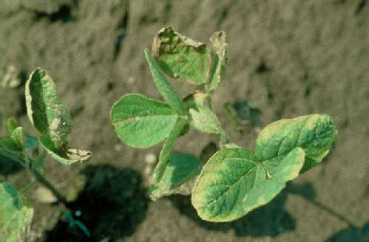
Metribuzin Injury

Slide 23
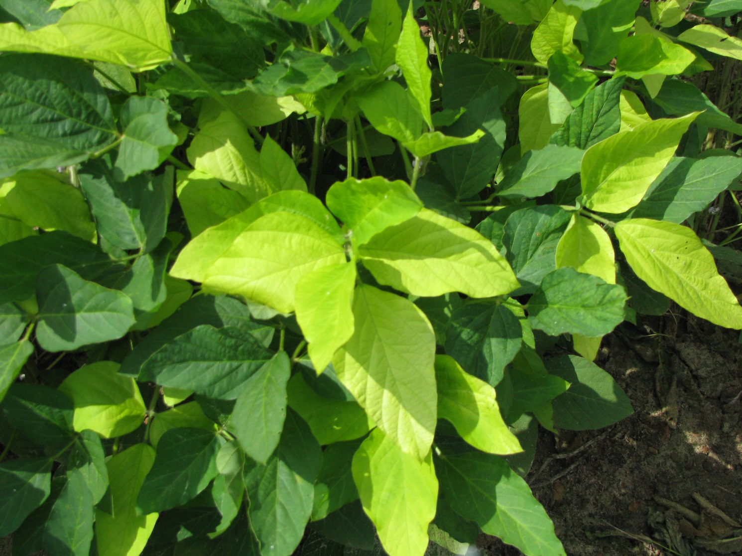
Glyphosate Yellow Flash

Slide 24
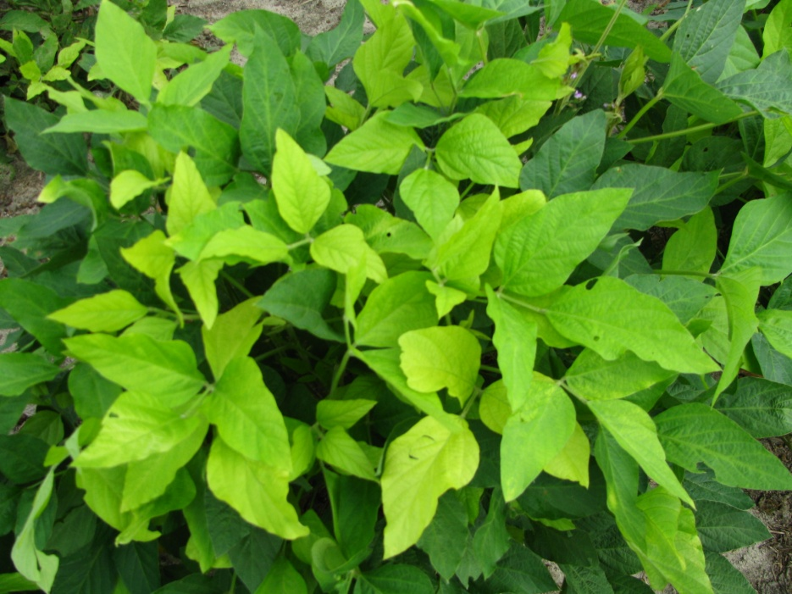
Likely Cause of Glyphosate Yellow Flash
Degradation of glyphosate to AMPA
AMPA reduces chlorophyll content in soybean
AMPA = aminomethylphosphonic Acid

Slide 25
Recent Research on Glyphosate and Mineral Accumulation
“Glyphosate is unlikely to cause macro and micronutrient deficiencies in soybean if soil nutrient levels are properly maintained.”
  Henry, R.S, K.A. Wise, and W.G. Johnson. 2011. Glyphosate’s effect upon mineral accumulation in soybean. Online. Crop Management doi:10.1094/CM-2011-1024-01-RS.
“Considering the available data, growers are unlikely to need Mn fertilizers just because they use glyphosate on GR soybeans.”
  Duke, S.O., J. Lydon, W.C. Koskinen, T.B., Moorman, R.L. Chaney, and R. Hammerschmid. 2012. Glyphosate Effects on Plant Mineral Nutrition, Crop Rhizosphere, Microbiota, and Plant Disease in Glyphosate-Resistant Crops. J. Agric. Food Chem. 60:10375−10397

Slide 26
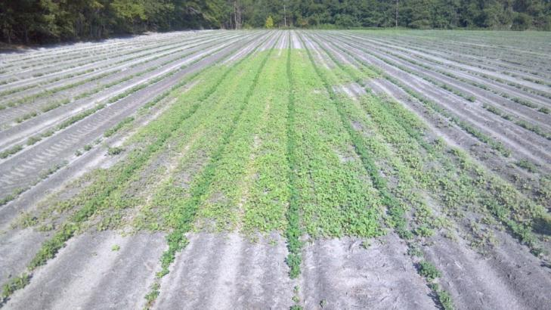
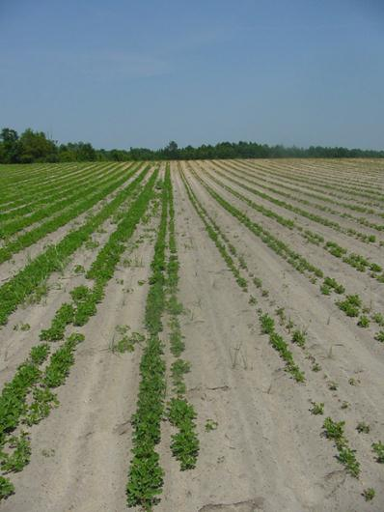
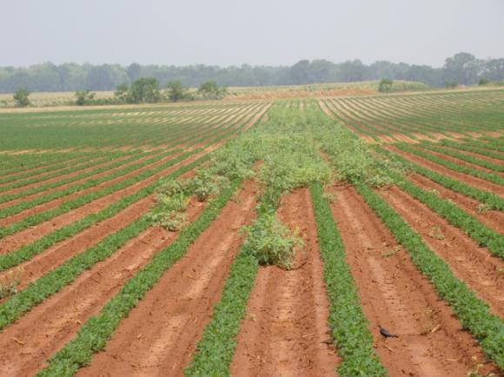

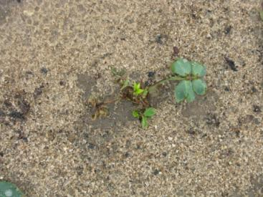
Valor
Great Weed Control vs. Crop Injury

Slide 27
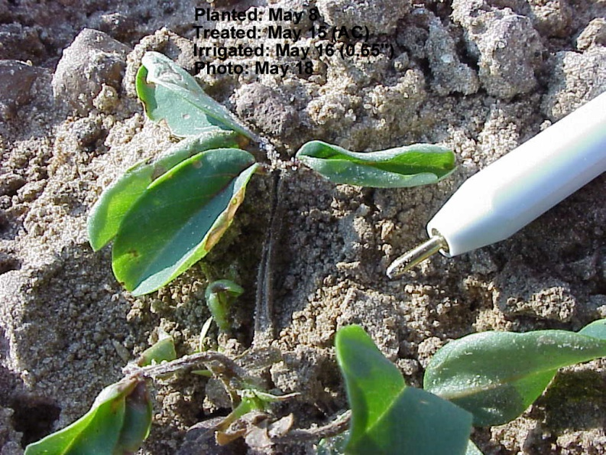
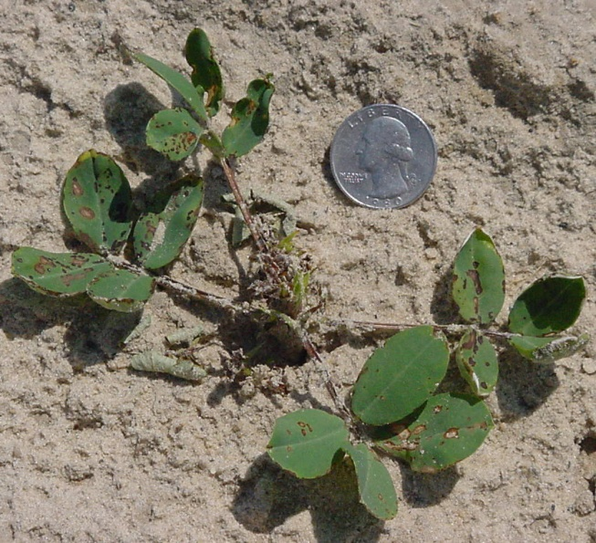
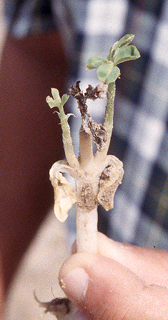
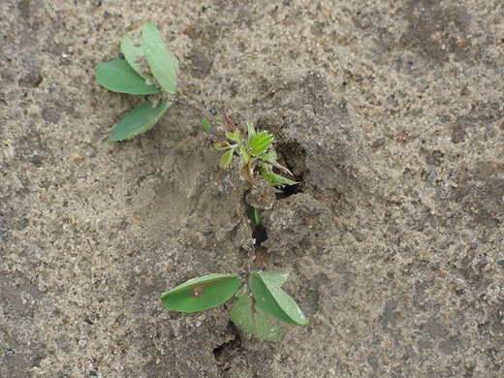
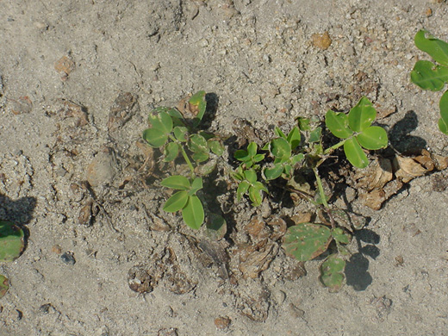
Valor Injury in Peanut

Slide 28
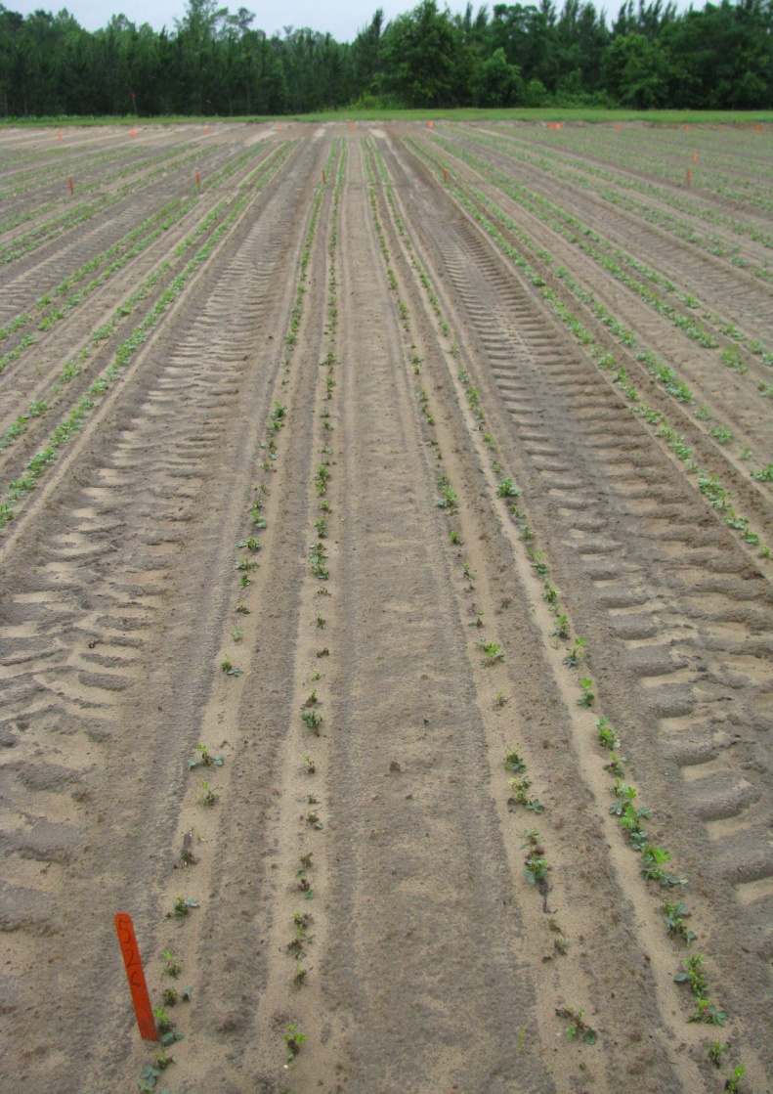
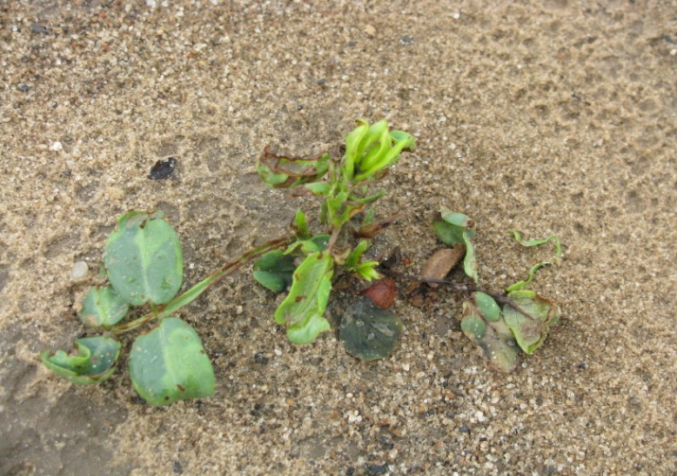
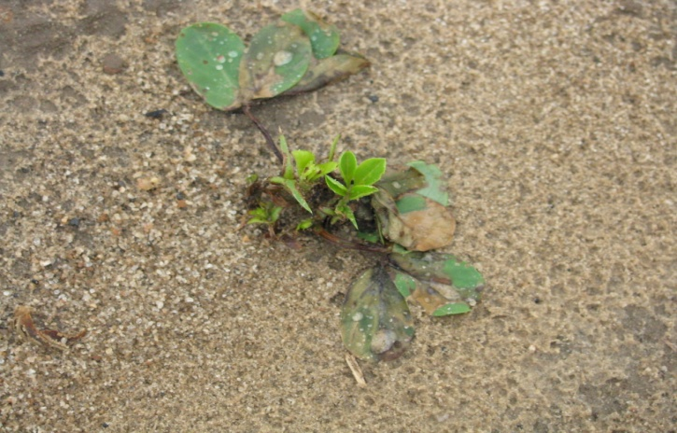
Valor Injury @ (6 oz/A)
16 DAT
PD: May 5
Rainfall Events:
May 5 = 0.04”
May 14 = 0.56”
May 15 = 0.16”
May 16 = 0.01”
May 17 = 0.51”
May 20 = 0.07”
May 21 = 0.59”
May 22 = 0.58”
May 23 = 0.24”
May 24 = 0.13”
May 25 = 0.20”
May 26 = 0.89”
May 28 = 0.05”
June 3 = 0.08”
June 4 = 0.56”
June 5 = 0.77”
30 day rainfall
total from planting = 5.44”
PE-08-09
May 22, 2009

Slide 29
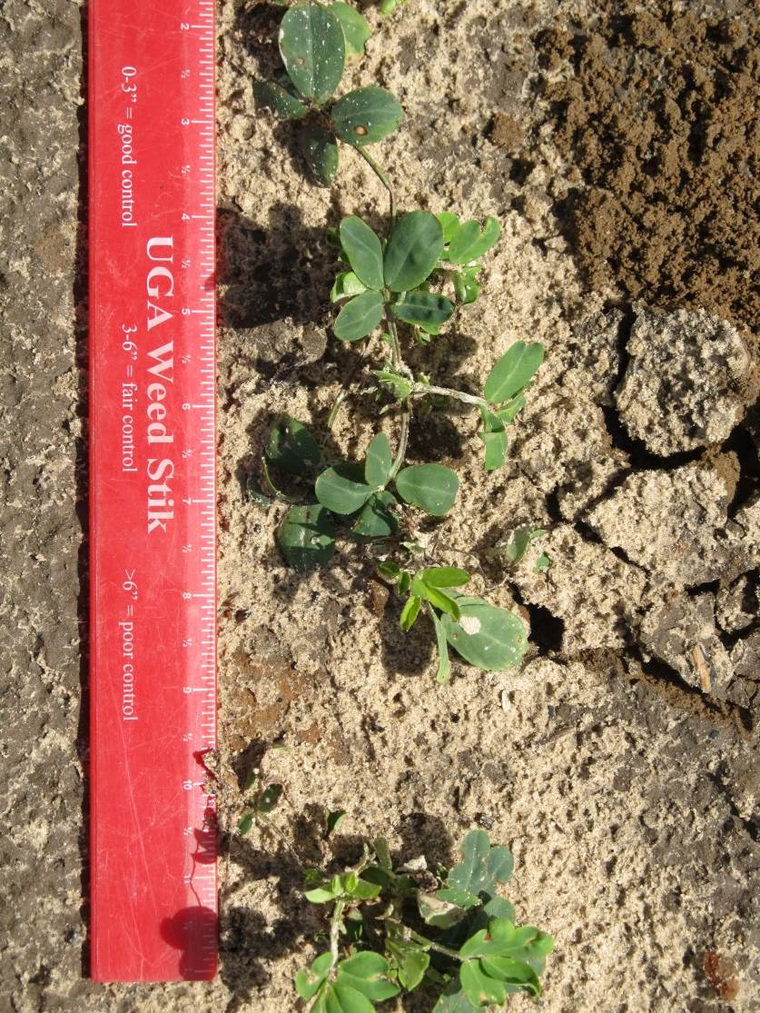
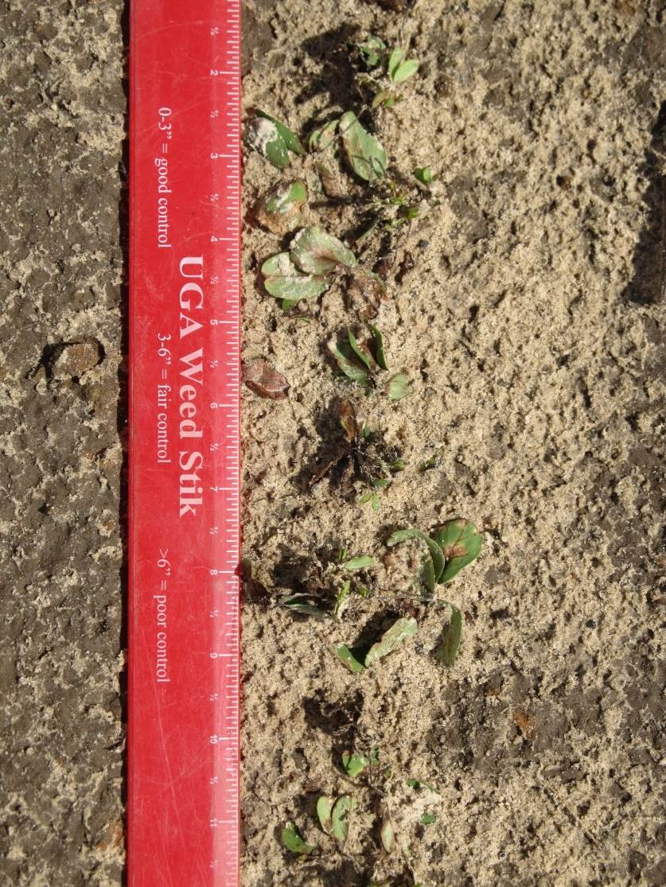
Valor SX 51WG Injury - 2018
PE-06-18
May 23
16 DAP
3.11” (R/I)
3 oz/A
6 oz/A

Slide 30
Peanut Yield Response to Valor - 2009
LSD 0.10 = 185
PE-08-09
Averaged over 3 varieties
(GA Green, GA-06G, GA-07W)
Weed-free

Slide 31
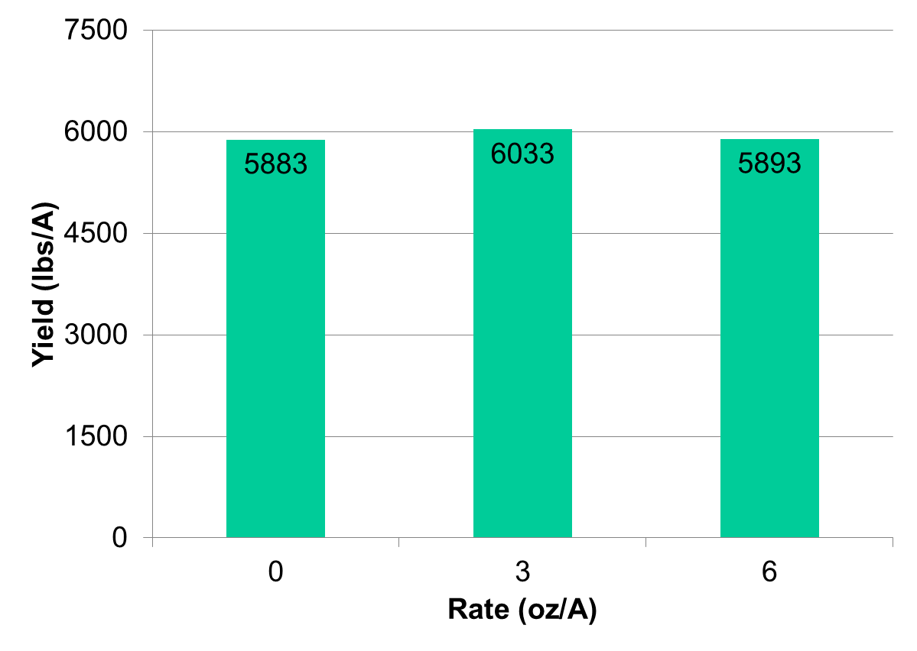
Peanut Yield Response to Valor 51WG - 2013
PE-14-13
GA-06G
Averaged over 3 planting dates (April 16, April 29, May 13)
Weed-free
P=0.4015

Slide 32
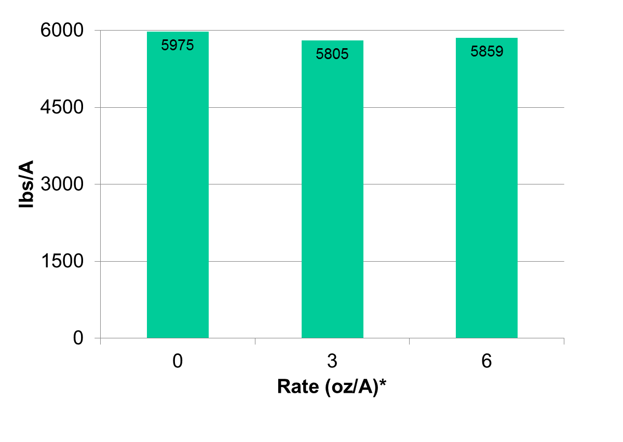
Valor Effects on Peanut Yield - High Moisture Conditions - 2018
11.315” rainfall/
irrigation first
30 DAP
*averaged over 4 Dual Magnum rates
PE-09-18
Weed-free
P = 0.7674, CV = 11.3

Slide 33
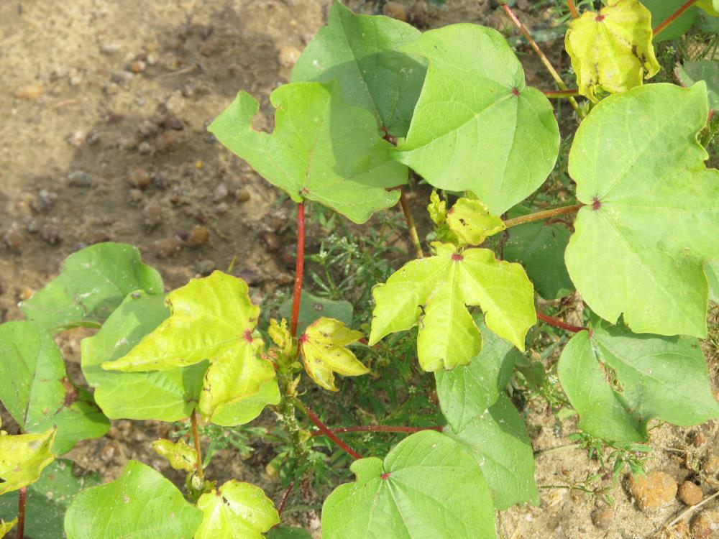
Cadre/Cotton

Slide 34
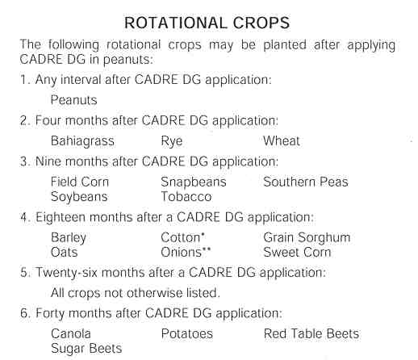
Cadre/Impose Rotational Restrictions

Slide 35
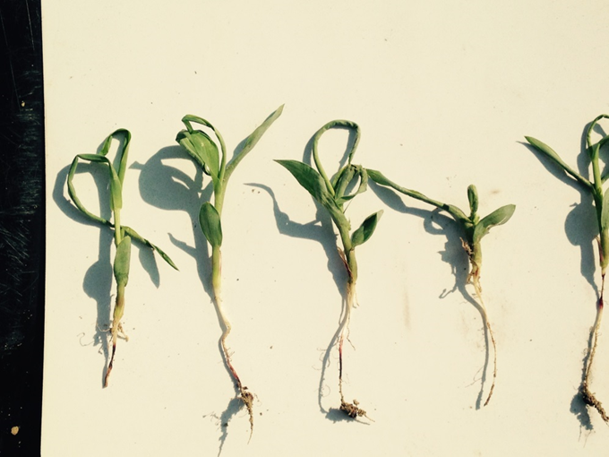
Dual/Warrant Injury on Sorghum

Slide 36
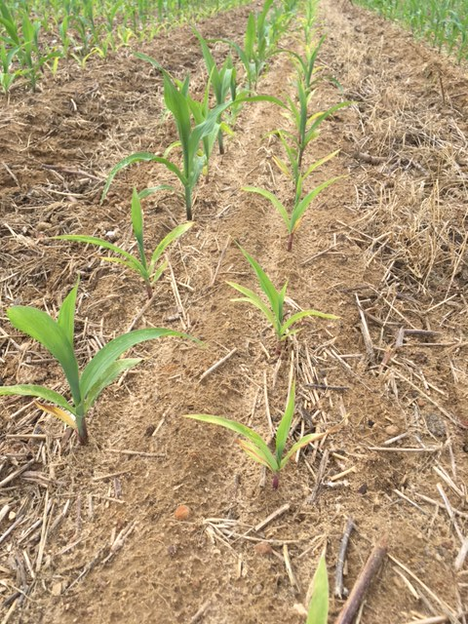
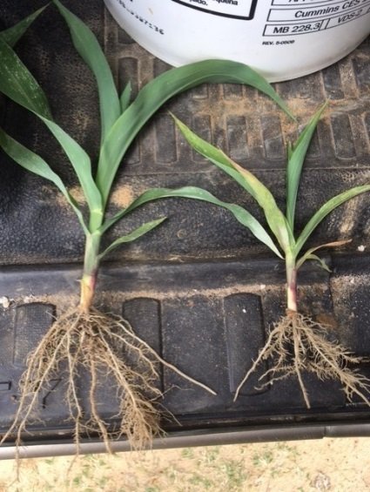
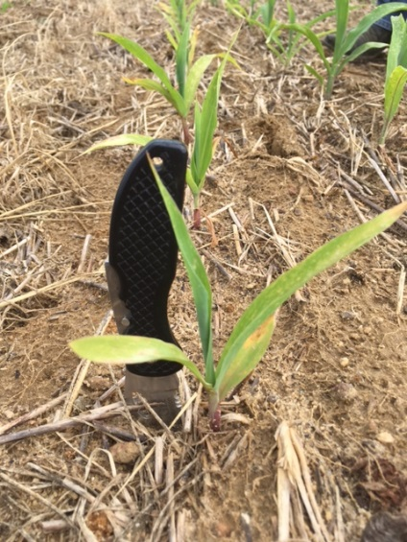
Herbicide Carryover or Nematodes
Burke County
April 2017
Stubby Root Nematodes
21/100cm³ of soil
>9 is threshold

Slide 37
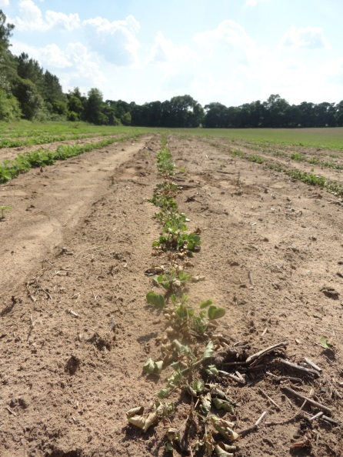
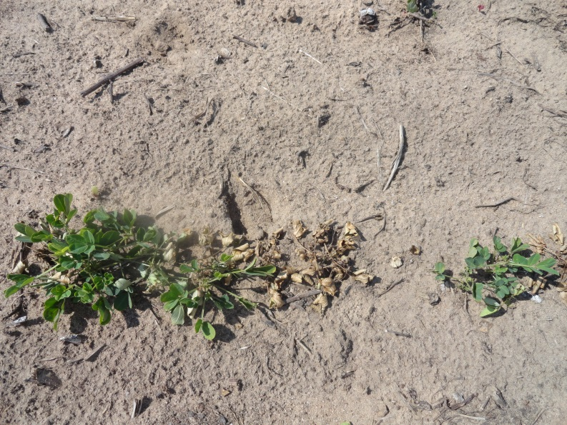
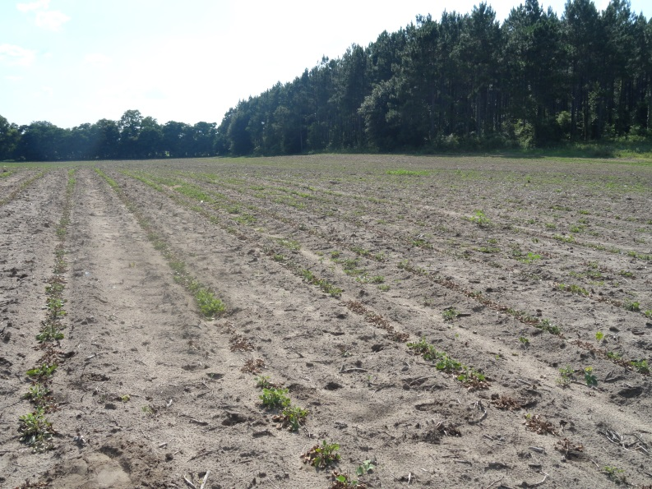
Brooks Co. - 2014
Low pH = 5.3
Very high Zn = 25 lbs/A

Slide 38
Peanut/pH/Zinc

Slide 39
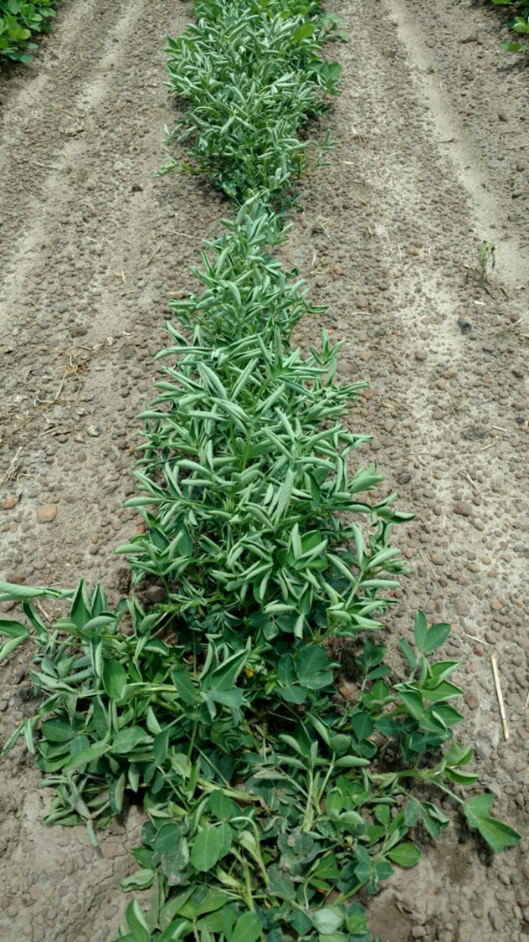
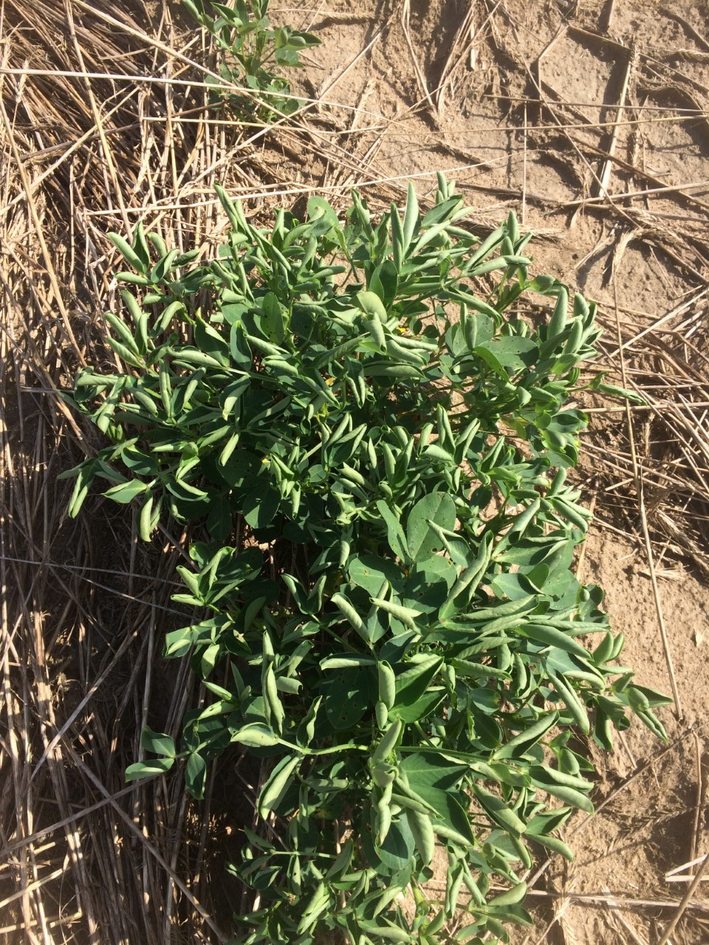
Recent Picloram Episodes - 2016
Mitchell County (GA)
June 20, 2016
Baldwin County (AL)
June 23, 2016

Slide 40
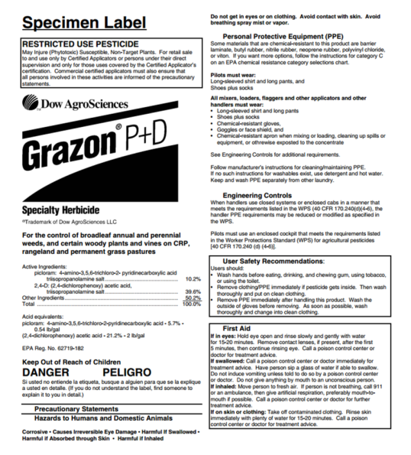
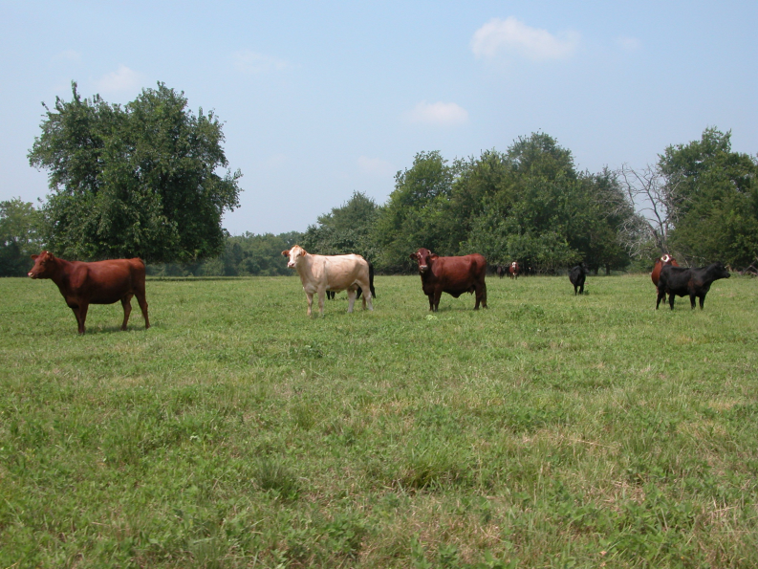
Grazon P+D
Picloram (0.54 lb/gal) and 2,4-D (2 lb/gal)
Picloram was first introduced in 1963 as Tordon 101
WSSA MOA #4 (synthetic auxin)
broadleaf annual and perennial weeds in rangeland and permanent grass pastures
Picloram has average field half-life of 90 days (20-300 day range)

Slide 41


Peanuts/Picloram
UGA Results
1/10th X rates of Grazon P+D reduced peanut yields by 11%
1/100thX rates of Grazon P+D caused injury symptoms but not yield loss.

Slide 42




Glyphosate/Peanuts

Slide 43

Questions/Comments

